Slide 1
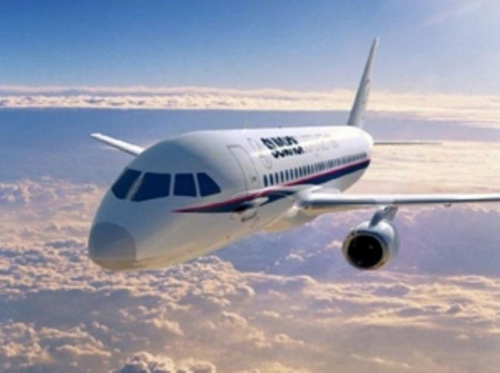
Airplane

Slide 2
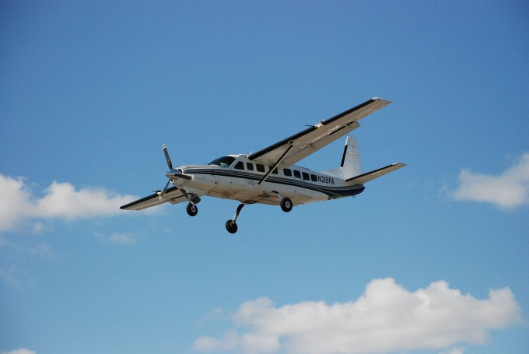
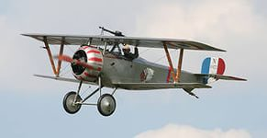
Interesting facts:
Under the Civil Code of the country: Airplanes and ships belong to the property. Here's a moving property.
According to statistics, three out of one hundred suffer aerophobia - panic fear of flying. It's a shame, because without this mode of travel is not possible to go in so many corners of the globe.
Once during a flight in the cabin Boeing saw ... a mouse. Because of the gray rodent crew had to make an emergency landing and all passengers. There was a danger that the mouse gnaw any cable. As a result, 200 passengers spent the night at the airport, and the crew all night caught a mouse with cheese and mousetraps. But they could not do anything! Then they brought several cats that are easily handled with the mouse

Slide 3
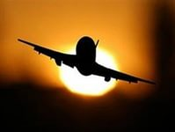
The highest altitude at which the aircraft climbed -37,650 m. In '77 it reached the Soviet pilot on an airplane Mikoyan.
Maximum height from which man fell and survived -10 km 160 m. At the time of the crash in '72 stewardess survived and install this sad record.
According to statistics, air travel - travel is the safest!
According to statistics, 84% of Russian citizens believe that travel on airplanes are dangerous and are afraid to fly on airplanes.
Contrary to popular belief, if the panic inherent in women, psychologists say that the feeling of fear before the flight equally covers both women and men.

