Slide 1
Country Profile
Pomogalova Polina 9 «A»

Slide 2
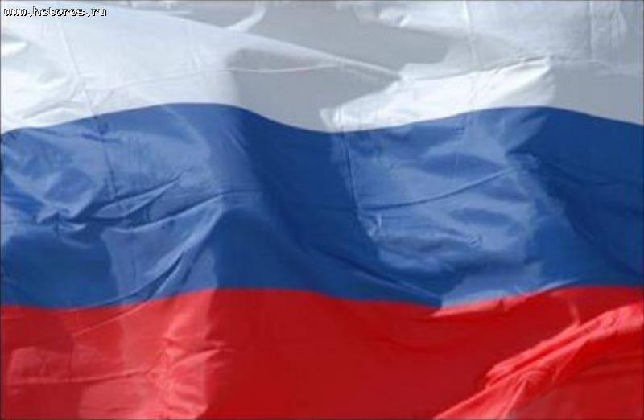
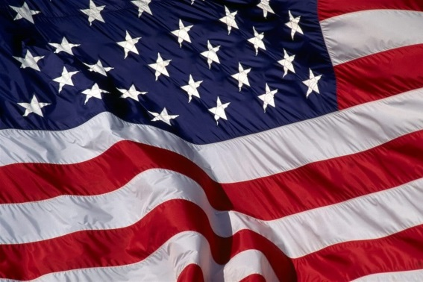
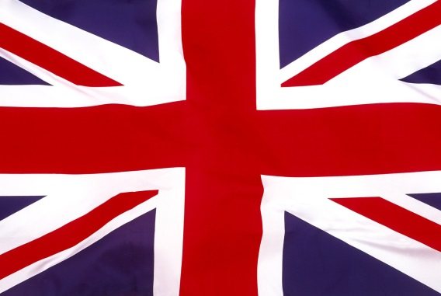
RUSSIA
U.S.A.
U.K.
The Russian Federation
The United States Of America
The United Kingdom Of Great Britain
Location: Eurasia
Area: 17 million sq km
Official language: Russian
Population: 140.3 million
Ethnic groups: Russian,
Tatar, Ukrainian, Chuvash,
Bashkir, Belarussian, Mordva
Location: America
Area: 9.8 million sq km
Official language: English
Population: 317.6 million
Ethnic groups: Americans,
African, Hispanics, Asian,
Pacific Islanders
Location: Europe
Area: 242.5 thousand sq km
Official language: English
Population: 61.8 million
Ethnic groups: English, Irish,
Welsh, Scots

Slide 3
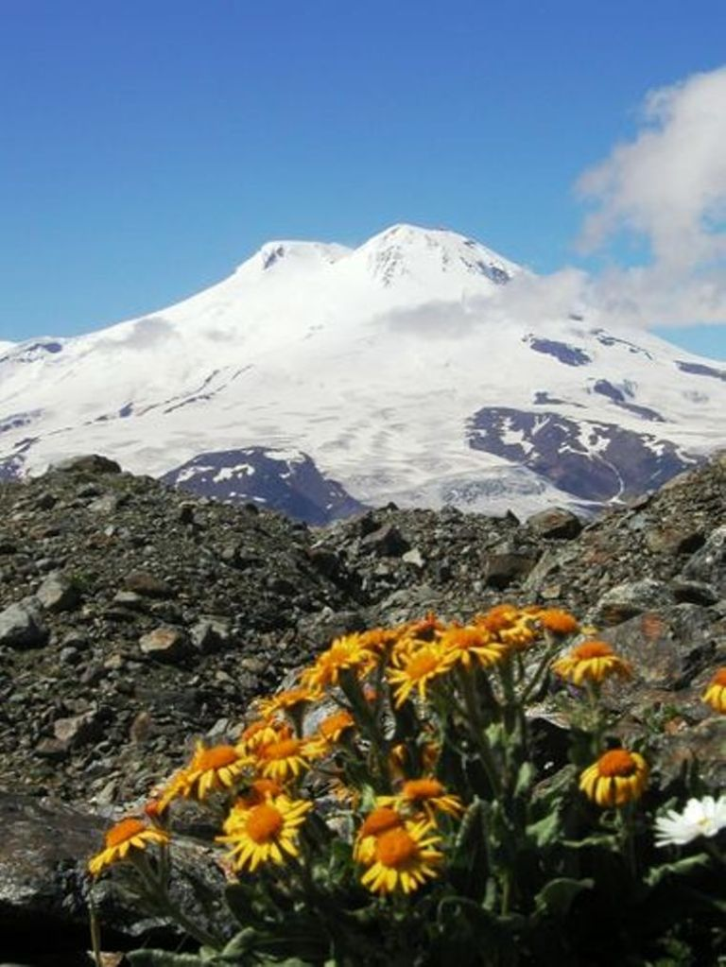
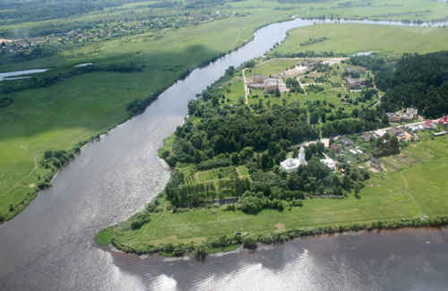
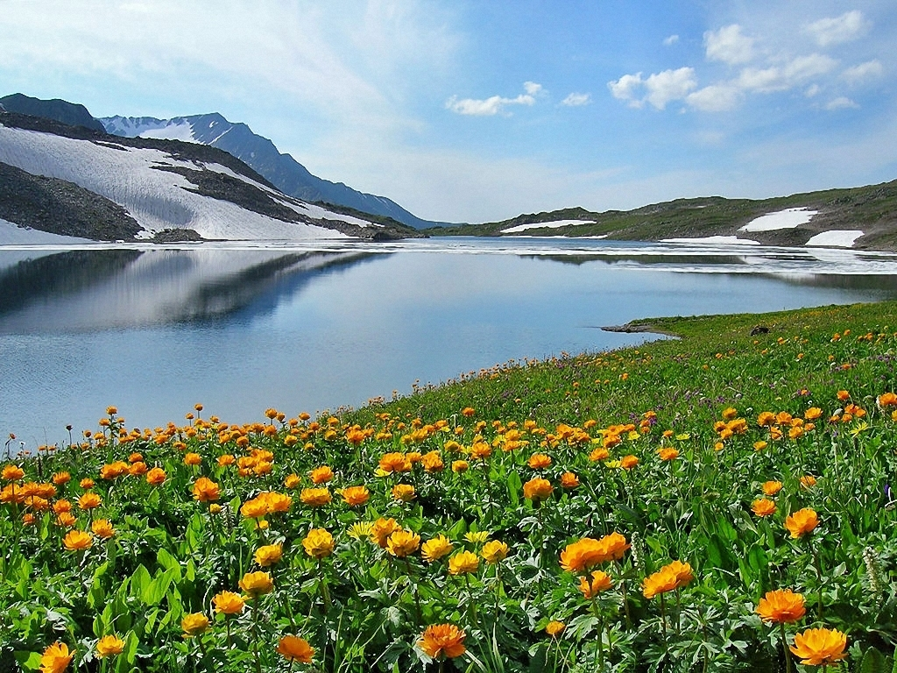
The Russian Federation
Highest Mountains is Elbrus (5,642 metres)
Longest River is
The Lena (4,400 km)
Largest Lake is Baikal
(31,5 sq km)

Slide 4
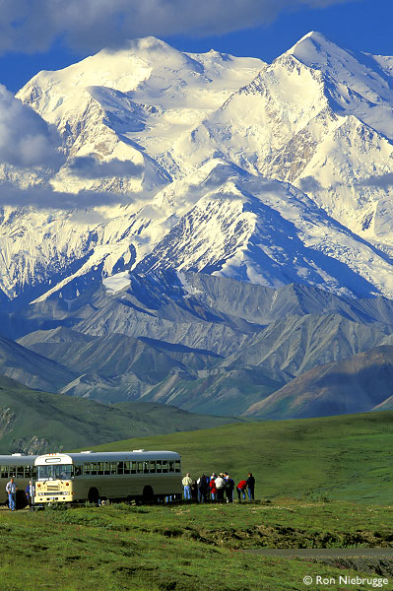
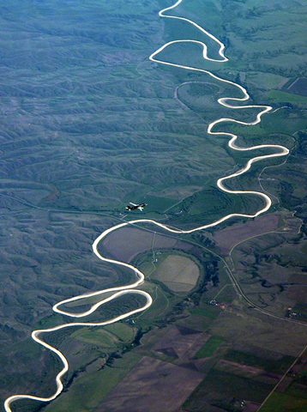
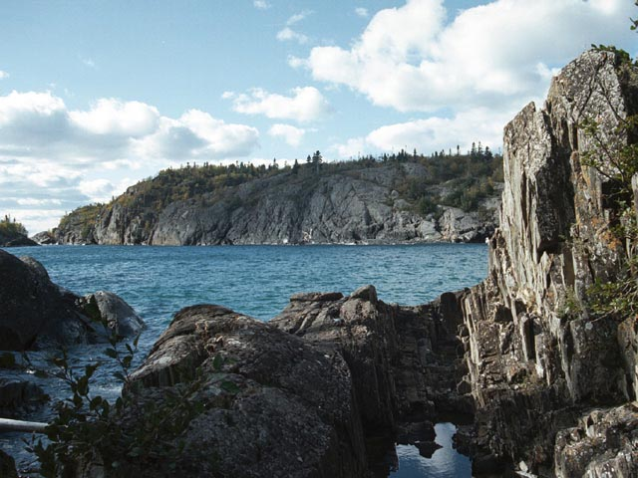
The United States Of America
Highest Mountains is Mount McKinley (6,194 metres)
Longest River is
The Mississippi-Missouri
(6,019 km)
Largest Lake is Superior
(83,270 sq km)

Slide 5
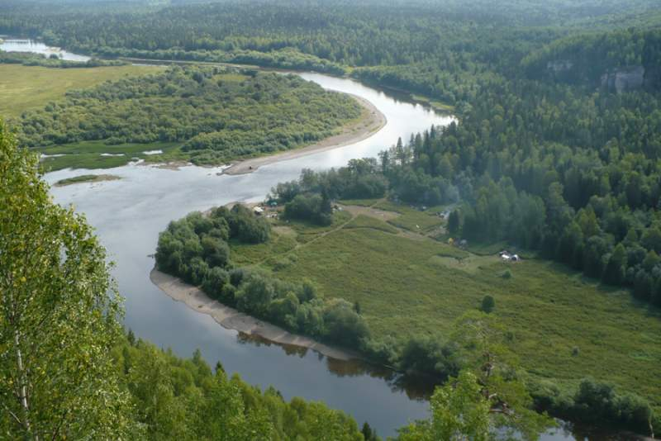
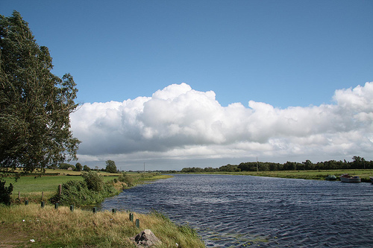
The United Kingdom Of Great Britain
Highest Mountains is
Ben Nevis (1,343 metres)
Longest River is
The Severn (354 km)
Largest Lake is Lough
Neagh (382 sq km)

Slide 6
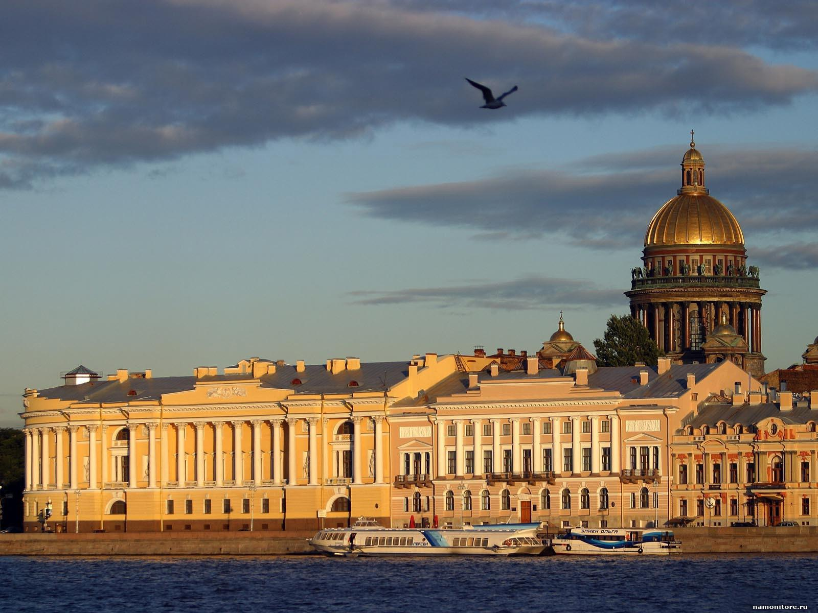
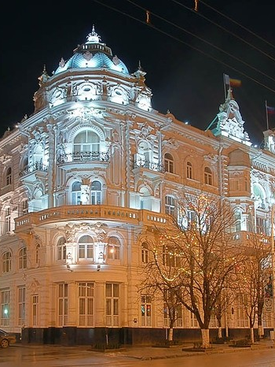
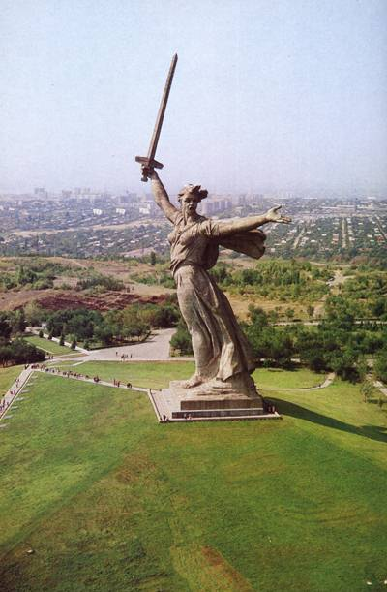
The Russian Federation
Major Cities
St PETERSBURG
ROSTOV-ON-DON
VOLGOGRAD

Slide 7
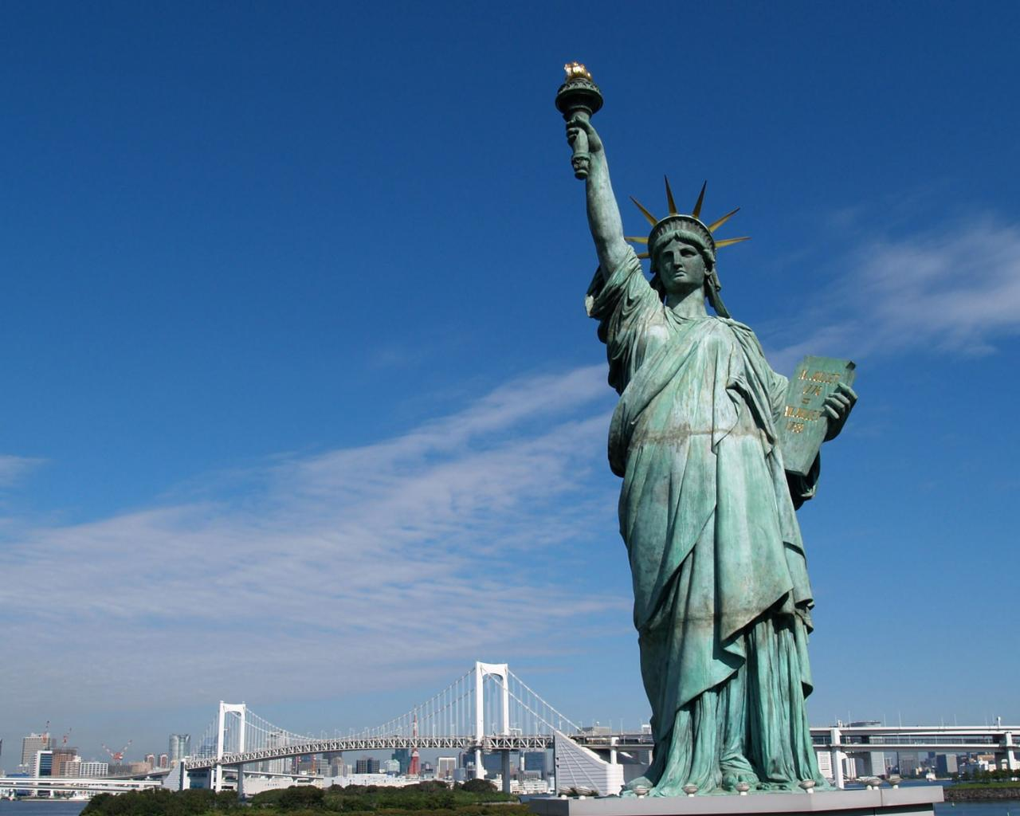
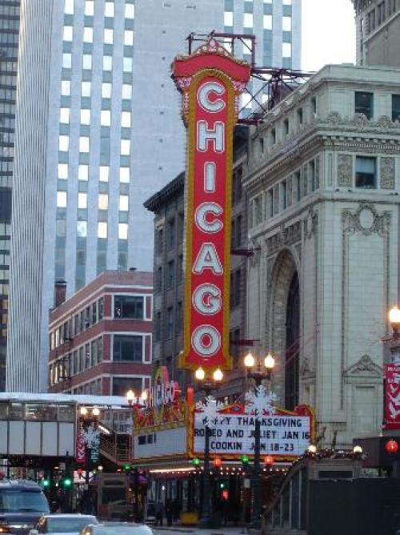
The United States Of America
Major Cities
NEW YORK
LOS ANGELES
CHICAGO

Slide 8
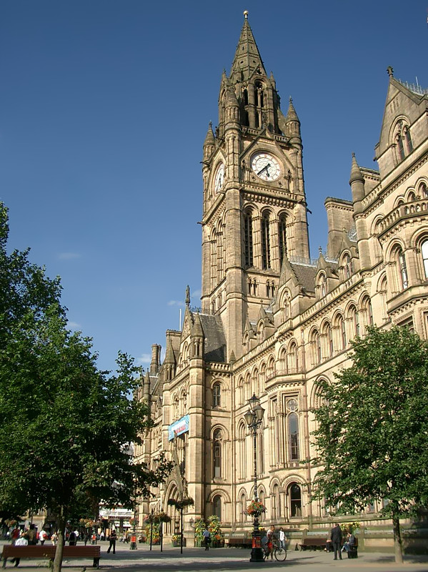
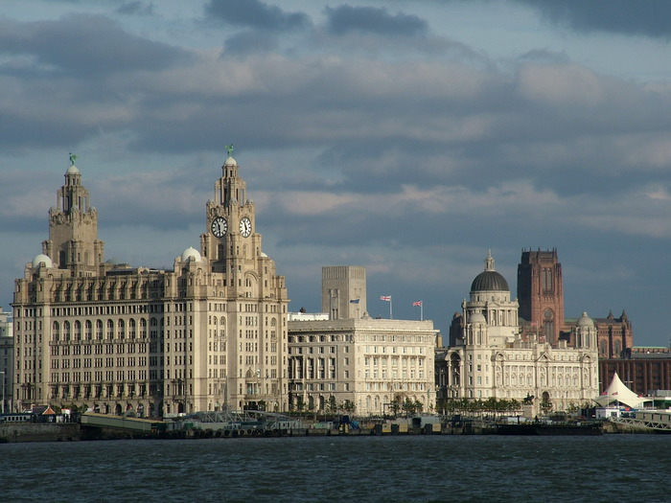
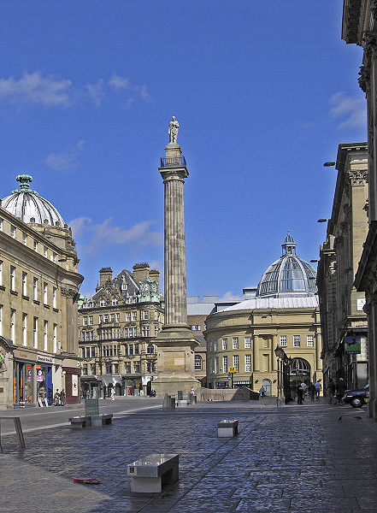
The United Kingdom Of Great Britain
Major Cities
MANCHESTER
LIVERPOOL
NEWCASTLE

Slide 9
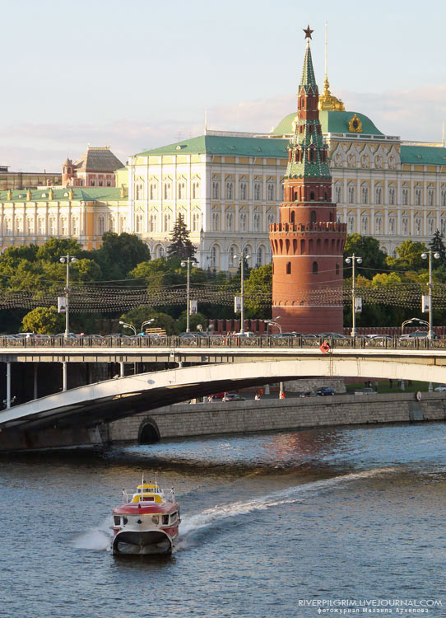
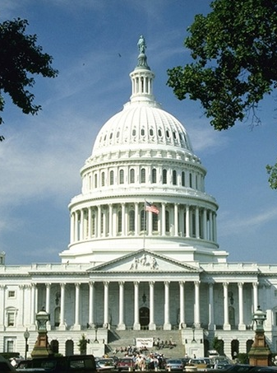
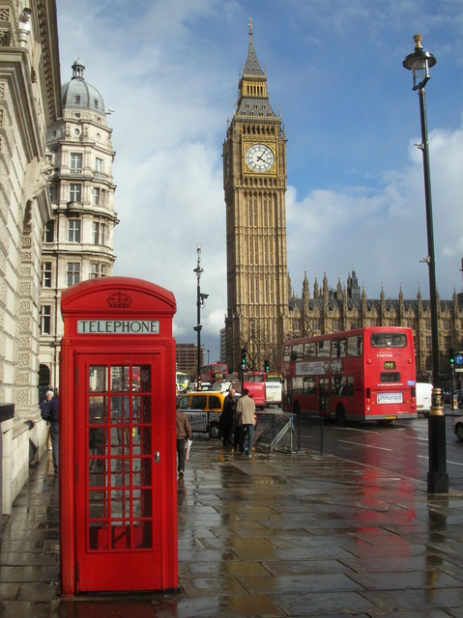
CAPITAL
MOSCOW is the capital of Russia
Washington is the capital of America
London is the capital
of Great Britain

Slide 10
