Slide 1
Television

Slide 2
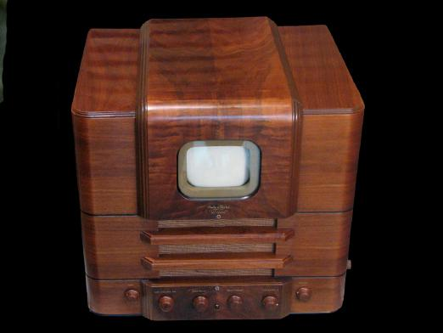
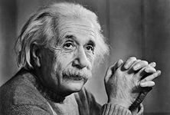
Creation
In fact it is difficult to understand who invented the first television. Many scientists took part in this. And even more than a dozen years it took to invent it. Let's try to start from the beginning.
The fact that light affects the electricity (the photoelectric effect), first discovered Heinrich Hertz (German physicist) in 1887. He painted his observations in detail but was not able to clearly explain this phenomenon. Alexander Stoletov in february 1888 was able to find some regularities of the photoelectric effect. He also has developed the "electric eye". Later this phenomenon many scientists have tried to explain, but only one of them was able to fully explain the nature of the photoelectric effect. They were Albert Einstein (1905).

Slide 3
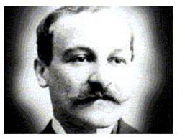
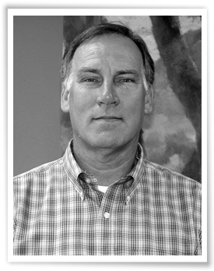
Scientists from France - Maurice Leblanc and scholar of America - E. Sawyer independently established the main principle of television. According to this principle in order to convey the image you want it fast scan frame by frame which is further transformed into an electrical signal.
Maurice Leblanc
E. Sawyer

Slide 4
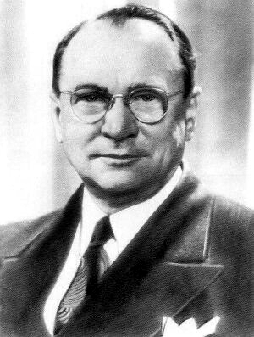
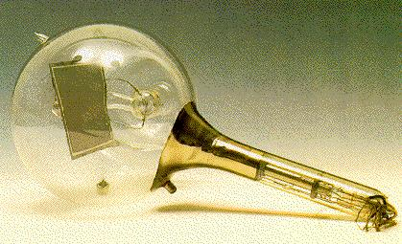
Boris Rosing in 1907 failed to substantiate how we get the picture, thanks to kinescope Brown. Vladimir Zworykin in 1933 in the US showed Ikonoskop.

Slide 5
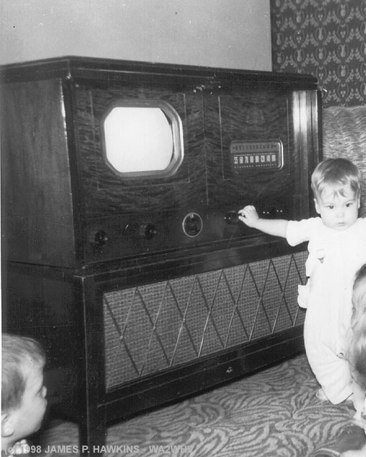
Zvorykina we consider the "father" of modern television. A first electronic television was developed in the American research laboratory, and which led Zworykin. Somewhat later in 1939 the same laboratory was demonstrated television for mass production.

