Slide 1
Ancient India

Slide 2
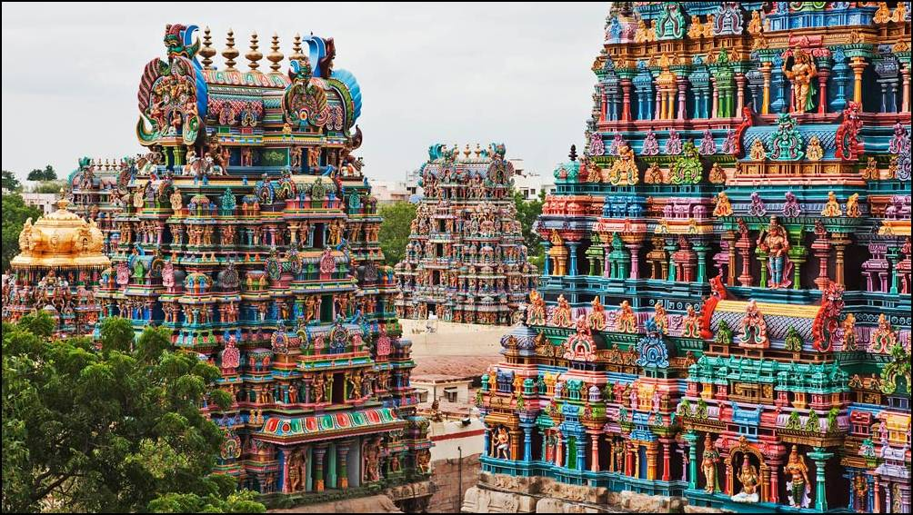
Ancient India - is one of the earliest civilizations in the world which brought the world's largest number of different culture and spiritual values.

Slide 3
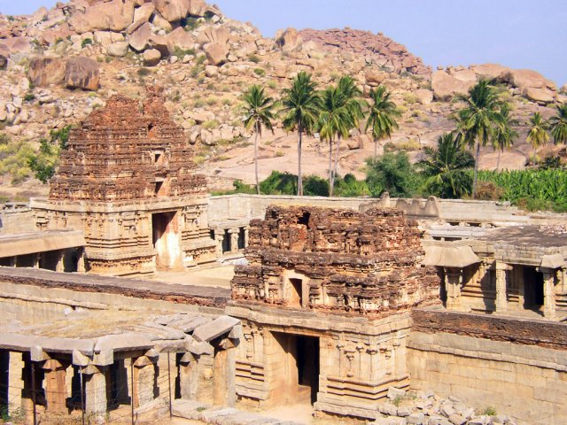
Various archaeological finds suggest that in ancient India was the human society in the Stone Age was born art appeared peoples. Indian civilization which appeared in the North-Western India

Slide 4
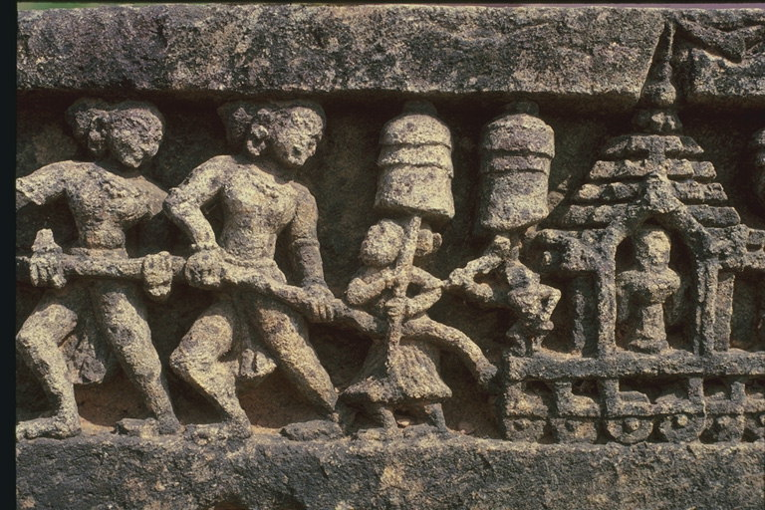
In the second millennium India came numerous tribes c alled themselves Aryans which means "noble". Their main wealth-animals . Then the cow was considered a sacred animal among the Indians . Since the end of the second millennium the spread of iron implements Indians are beginning to explore the valley of the Ganges clearing the jungle to drain the swamp. They sow rice, cotton.

Slide 5
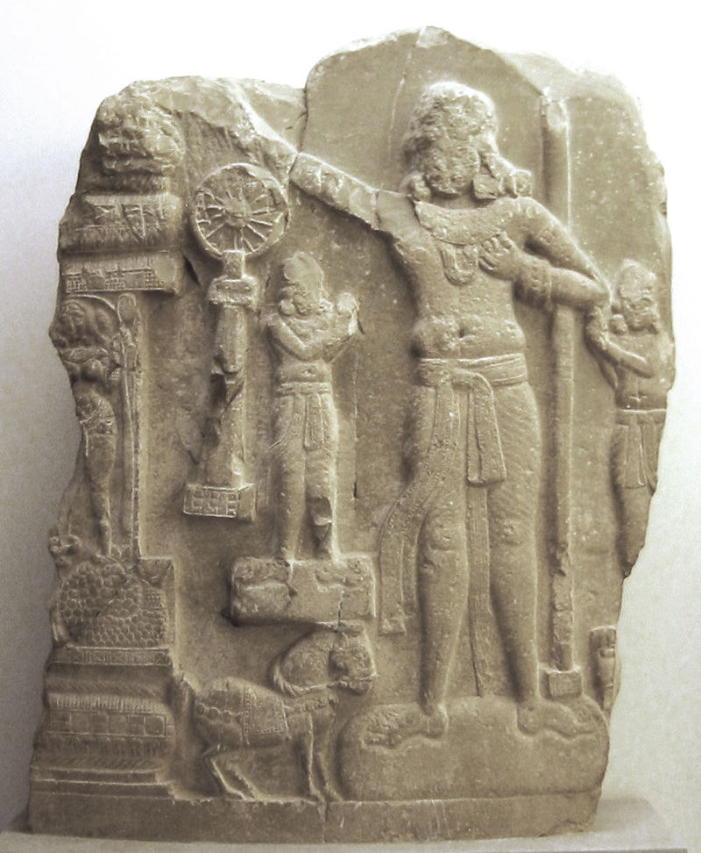
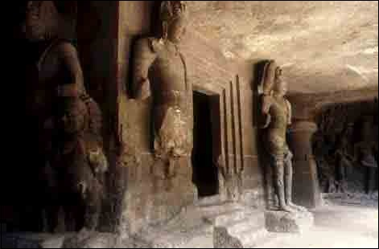
In India women's clothing has many kinds of related culture religion and climate. Traditional clothing for women in Northern and Western India are saris or Gagra choli.
Traditional clothing for men in India are considered Shervani, Lung, kurta, dhoti or pajama.

Slide 6
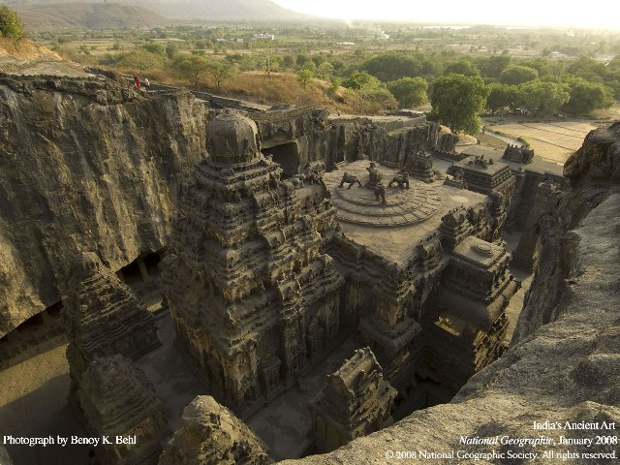

Slide 7
