Slide 1
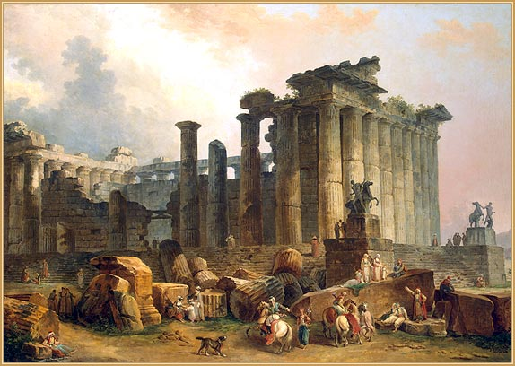
Ancient Rome: How it was
the civilization of ancient Rome was located in the Apennine peninsula. According to legend, Rome was founded in 753 BC by Romulus and Remus, who was raised a wolf.

Slide 2
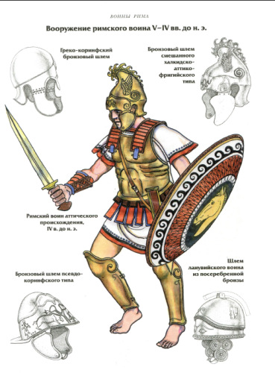
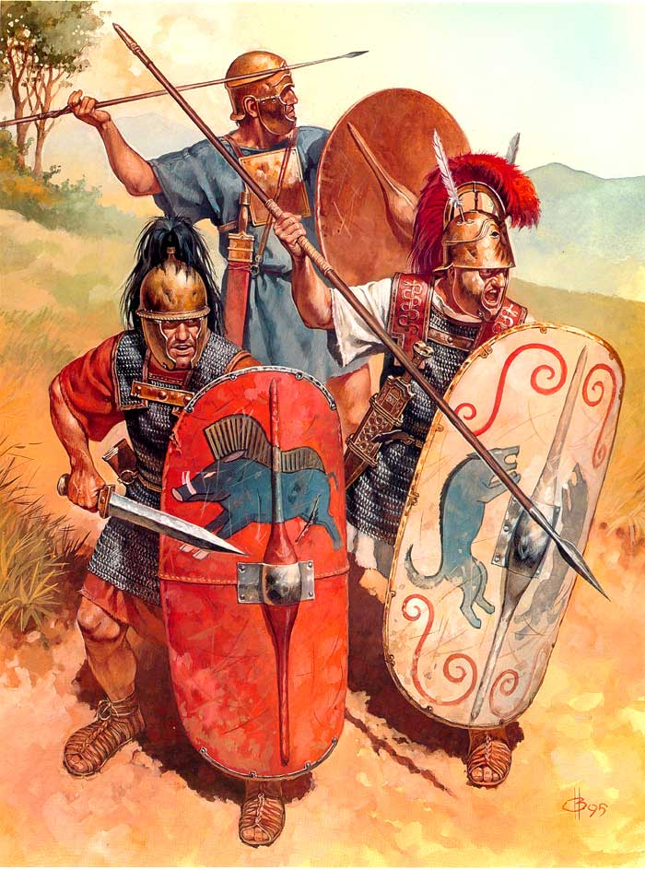
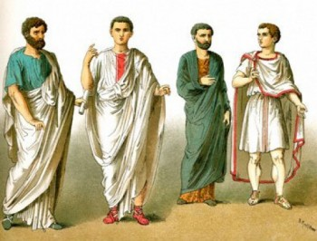
The ancient Romans appear to us harsh, physically strong, developed, hardy people. Judging from the portraits and busts, like they were in the present inhabitants of Northern Italy, Austria, Switzerland (medium height, gray eyes, blond or brown-haired). Romans appear to us harsh, physically strong, developed, hardy people. Judging from the portraits and busts, like they were in the present inhabitants of Northern Italy, Austria, Switzerland (medium height, gray eyes, blond or brown-haired).

Slide 3
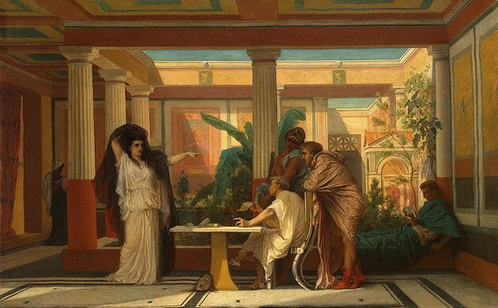
For better use of daylight Romans used to get up very early, often around four in the morning and, after breakfast, began to engage in public affairs. Like the Greeks, the Romans ate three times a day. Early in the morning - the first breakfast, around noon - the second in the evening - dinner.
Boys and girls started to train with seven years. Rich parents prefer home schooling. Poor schools used the services. Then was born and the prototype of the modern education: children pass through three stages of education: primary, secondary and higher education. Head of the family, taking care of the education of children, tried to hire teachers for their children or Greeks get to teach a slave-Greek. At the age of 17-18 years old young man had to leave the Roman doctrine and undergo military service.
Romans cared for and that the women were educated in connection with the role that they have in the family: the organizer of family life educator and early childhood.

Slide 4
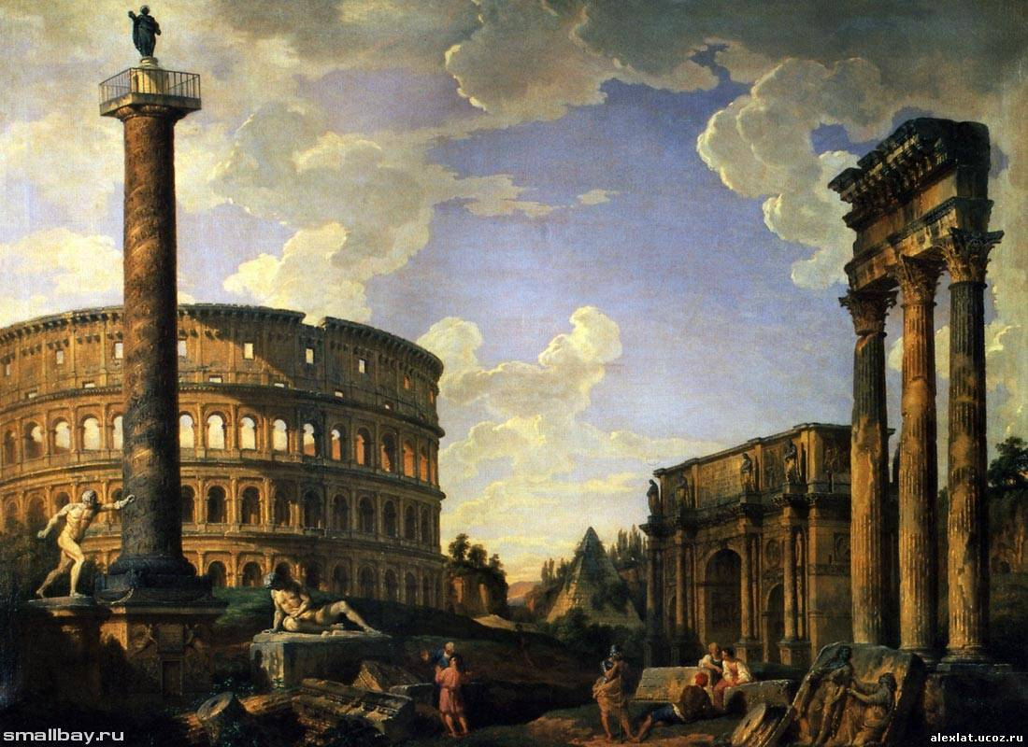
Ancient Rome to the modern world gave Roman law, some architectural forms and solutions (arch and dome) and many other innovations. For ex.: wheeled water mills. Christianity as a religion born in the territory of the Roman Empire.

