Slide 1
Kurt Donald Cobain

Slide 2
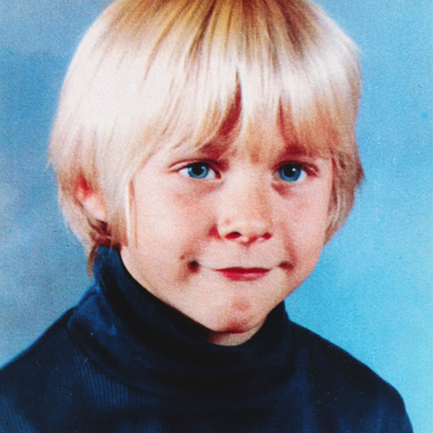
Kurt Donald Cobain was born February 20, 1967 in the city Hoquiam, the state of Washington. since childhood he was fond of rock and very well played guitar.

Slide 3
Nirvana has 3 studio albums, two mini-albums, 21 single, 5 video albums, 3 live albums, 5 compilations. In 1989 the group released their first album titled Bleach. The 1991 album — "Nevermind

Slide 4
Died Kurt Cobain April 5, 1994. Kurt committed suicide by shooting himself in the head with a gun, after taking a large dose of drugs that are not compatible with life

