Slide 1
First phone
XIX.

Slide 2
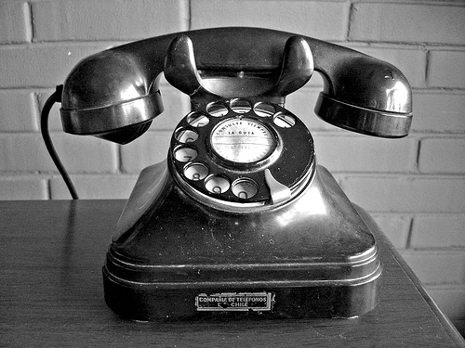
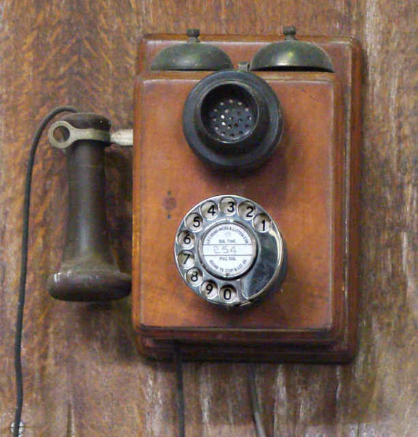
In the middle of the nineteenth century there was an idea to transfer at distance information by means of electricity. Who the first invented phone? For the first time, the teacher managed to carry out this idea physics to Philip Reys on the twenty sixth of October, 1861 in Germany. Its device had the original microphone, the power supply representing the galvanic battery, and the loudspeaker. This device was also called scientific Telephon.
Phone for the first time created and the Scottish scientist Alexander Graham Bell patented.

Slide 3
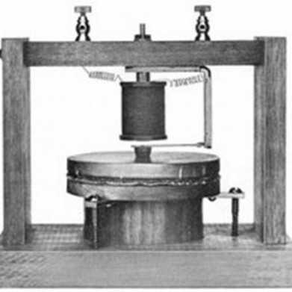
The device underwent numerous improvements. So, in the device Bella there was no call, and the tube served both for transfer of the human speech, and for its reception. In 1877 the famous inventor Vaden used the special cable key closing a call chain for the subscriber's call. Subsequently it was replaced with the button. In the same time the German plant "Siemens and Galsk" located in St. Petersburg began production the telephone sets having two tubes – for reception and a speech transmission.
First telephone set Bella.

Slide 4
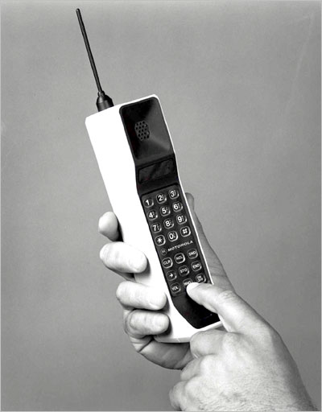
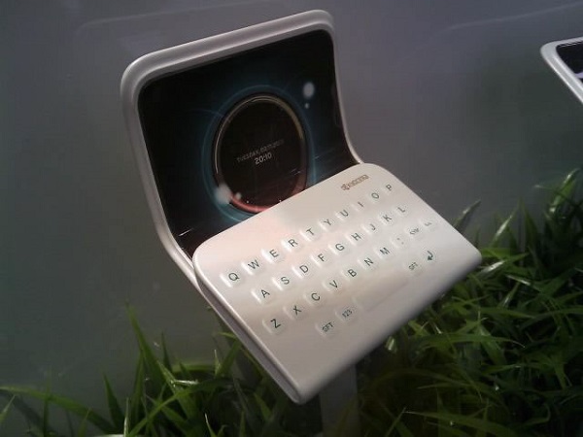
I consider that phone this necessary invention. By means of phone, the mankind came to the new level of communication. We can communicate at distance with the friends and relatives and to write each other letters without using paper and the handle

