Slide 1
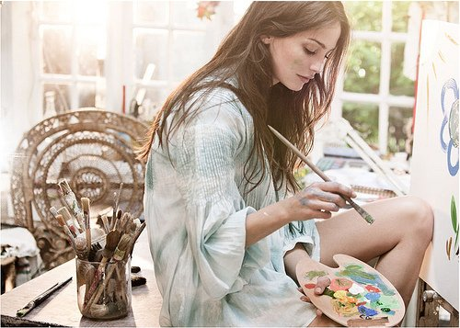
My profession in the future

Slide 2
In the future I want to become an artist

Slide 3
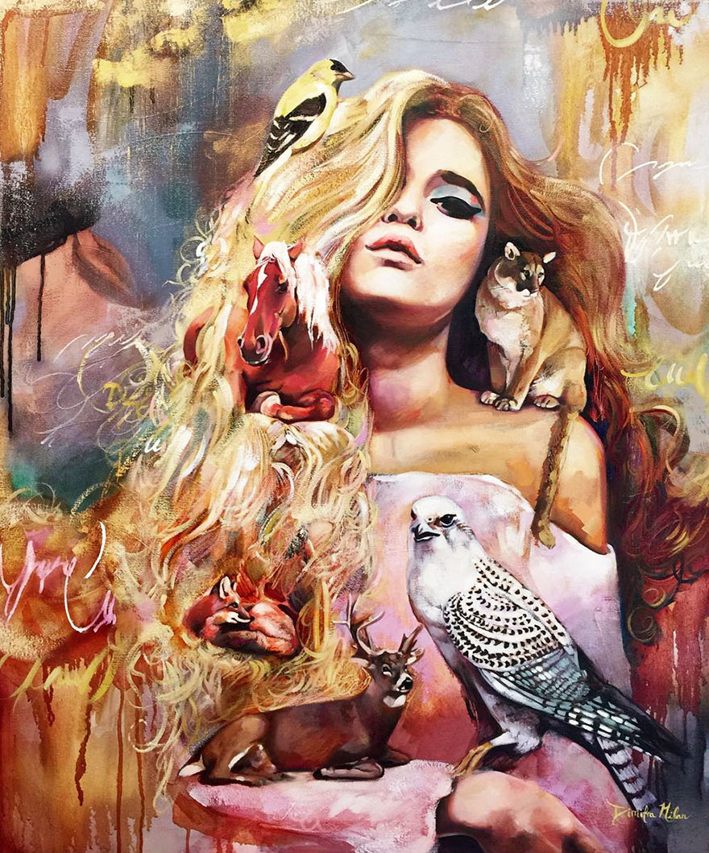
I want to be an artist because I love to draw, especially portraits

Slide 4
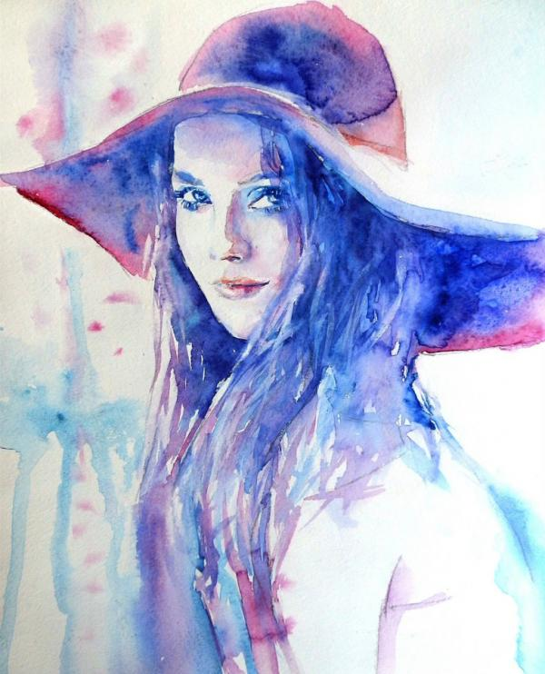
Your imagination helps you in this work. Most of all I like to draw with pencil, not paint. Because after she gave me the picture deteriorates.

Slide 5
Thank for watching

