Slide 1
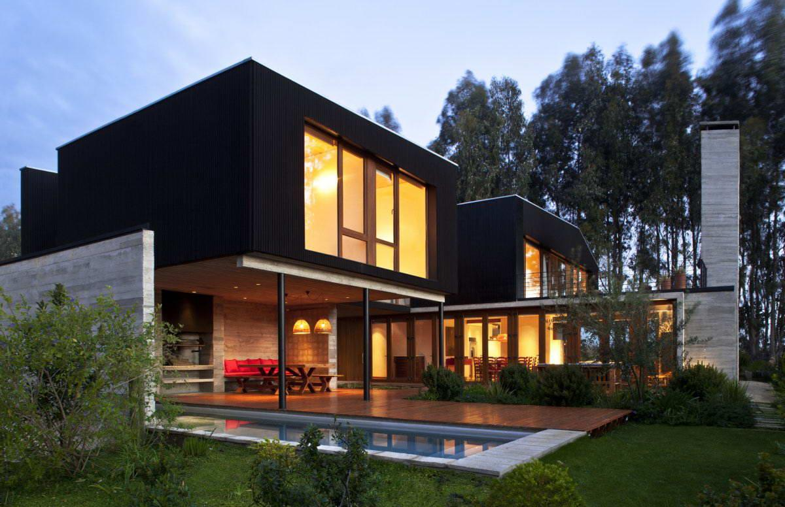
Nikita Gorbunov
What are you going to be ?

Slide 2
I’ll be an Architect
I will draw drawings . And I'll be responsible of the house .

Slide 3
What need have ?
To do this, I need to know the subject of Russia , Maths , And I need have to go to college.

Slide 4
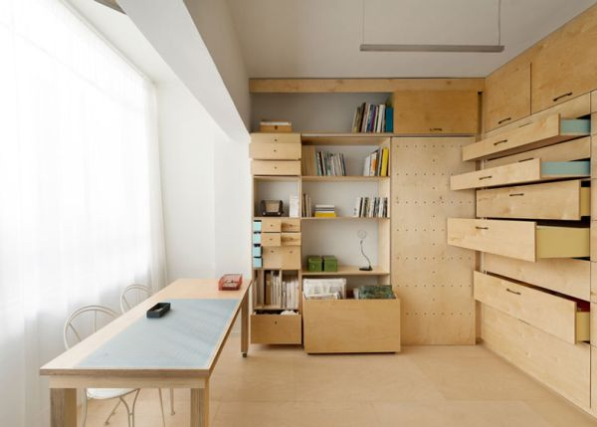
What I will?
I will a work room and computer . And I will sit down at the table and drawing the draw .

Slide 5
Thanks for watch !

