Slide 1
When I grow up I want to be…

Slide 2
a designer

Slide 3
because it is a creative profession and I like to draw.

Slide 4
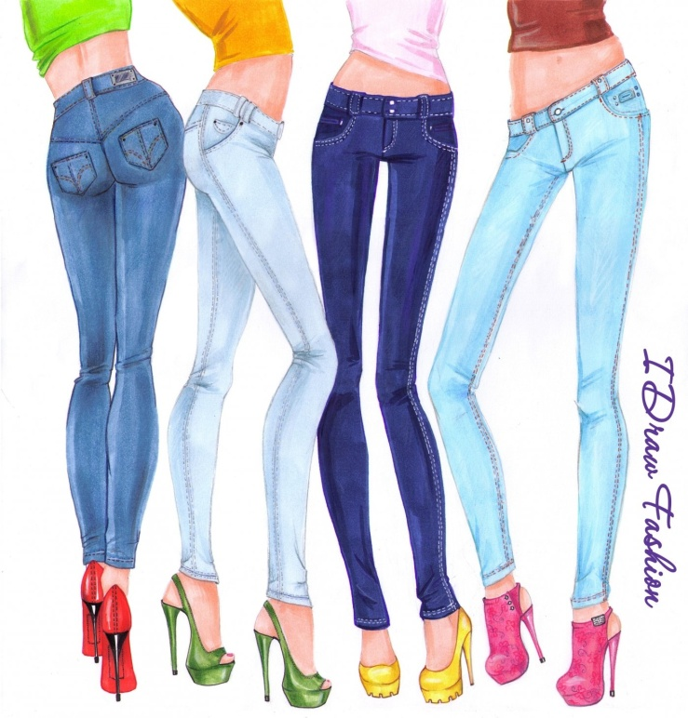
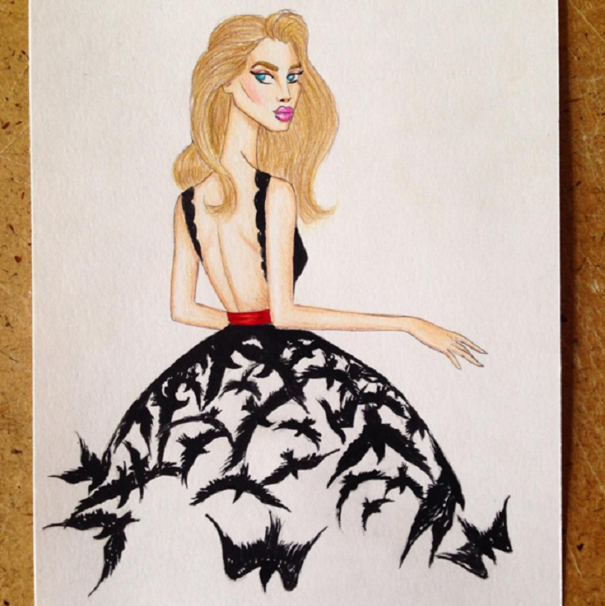
You can draw beautiful sketches

Slide 5
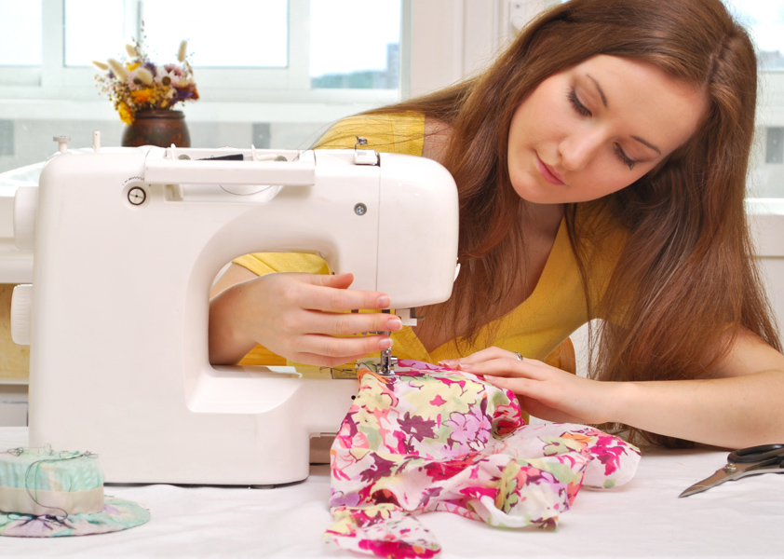
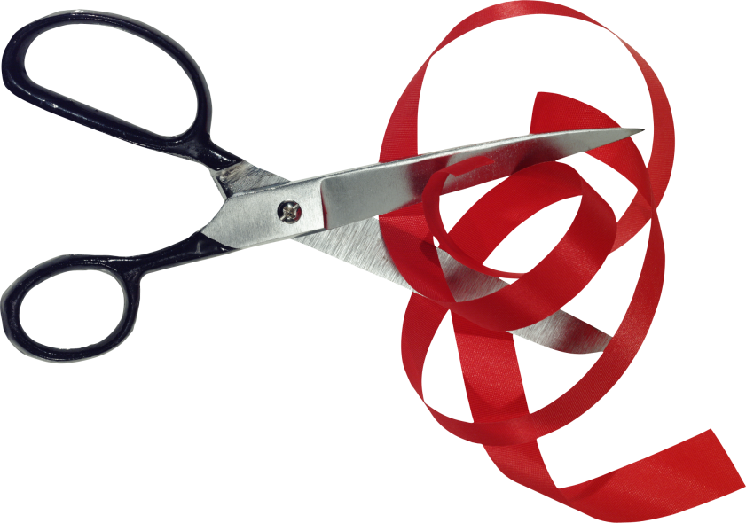
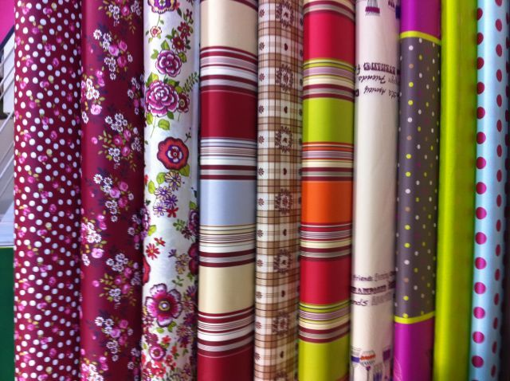
…and then sew

Slide 6
Thank for watching

